Slide 1
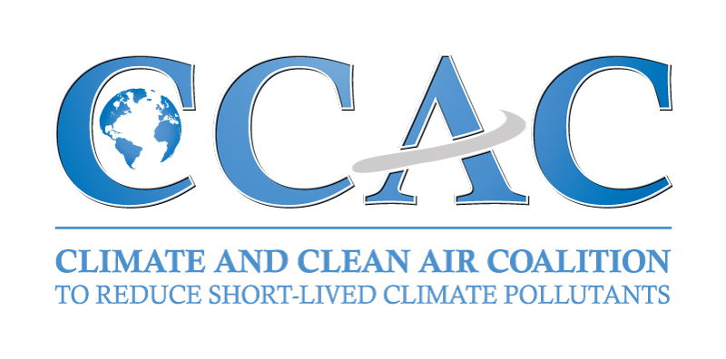
Air pollution, Energy and Health
Multiple Benefits from Reducing Short-Lived Climate Pollutants
Helena Molin Valdés
Head, CCAC Secretariat
Notes:
[Start talk on next slide]

Slide 2
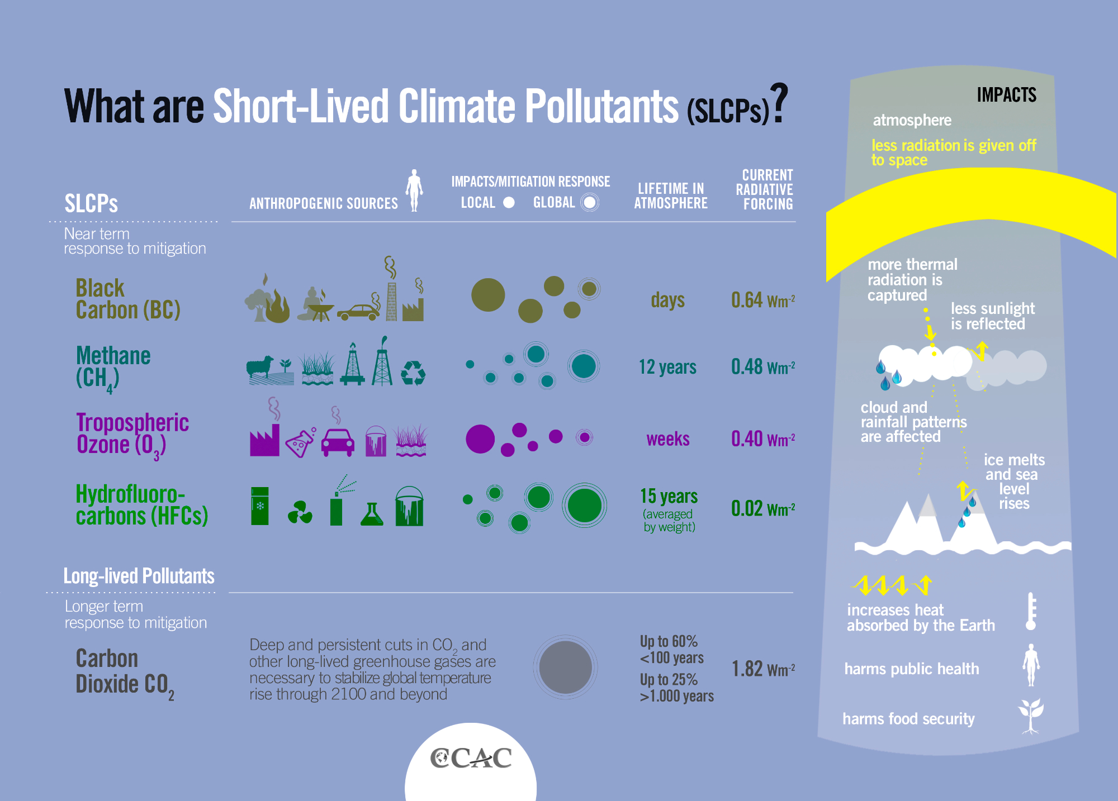
Notes:
[Before talking about the CCAC]
Outline that there is a global SLCP Challenge
What are SLCPs?
Point out 4 SLCPs: Black carbon, methane, tropospheric ozone and some HFCs are substances
As opposed to CO2 which is long-lived
Explain relatively short lifetimes in the atmosphere
But that SLCPs are responsible for a substantial fraction of near-term climate change
SLCPs AND HEALTH:
Black carbon and methane are two contributors to air pollution
Air pollution is now the world’s largest single environmental health risk
7 million people die annually from diseases related to household (indoor) air pollution and ambient (outdoor) air pollution.
Black carbon (or “soot”) is a tiny black particle emitted by incomplete combustion, from sources such as heavy-duty diesel vehicles, traditional cook stoves, coal-fired power plants, open burning of solid waste and brick production. When inhaled it penetrates deep into lung passageways and the cardiovascular system, increasing the risk of respiratory infections, heart disease, stroke and lung cancer. Black carbon particles absorb sunlight and warm the atmosphere, contributing to climate change.
Methane is a primary precursor of tropospheric ozone – known as ‘urban smog’. Approximately 60% of methane is emitted from human made sources – primarily from agriculture (livestock rearing and rice production), fossil fuel production and distribution, municipal waste and wastewater treatment. When inhaled this can worsen bronchitis and emphysema, trigger asthma, and permanently damage lung tissue. Methane is a very powerful greenhouse gas.

Slide 3
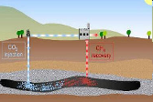
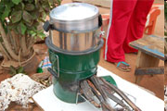
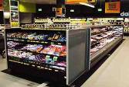
SLCP Measures
Methane
Degasification, recovery and use
Recovery from municipal waste & wastewater treatment
Reduce emissions from agriculture
Black carbon
Improve stoves (biomass to LPG/biogas, wood to pellet)
Upgrade brick kilns
Use particle filters for diesel vehicles
HFCs
Non-HFC technologies for refrigeration
Low-GWP, high energy-efficient foam blowing technologies
Efficacy for cooling technologies
16 measures:
≈- 40% methane, ≈- 80% BC in 2030 (rel. to BAU)
  No technical breakthroughs
  Already implemented in many countries
  Half reductions at low cost or cost-neutral
No ‘one-size-fits-all’ solution
Further R&D for effective and affordable alternatives and relevant infrastructure

Slide 4
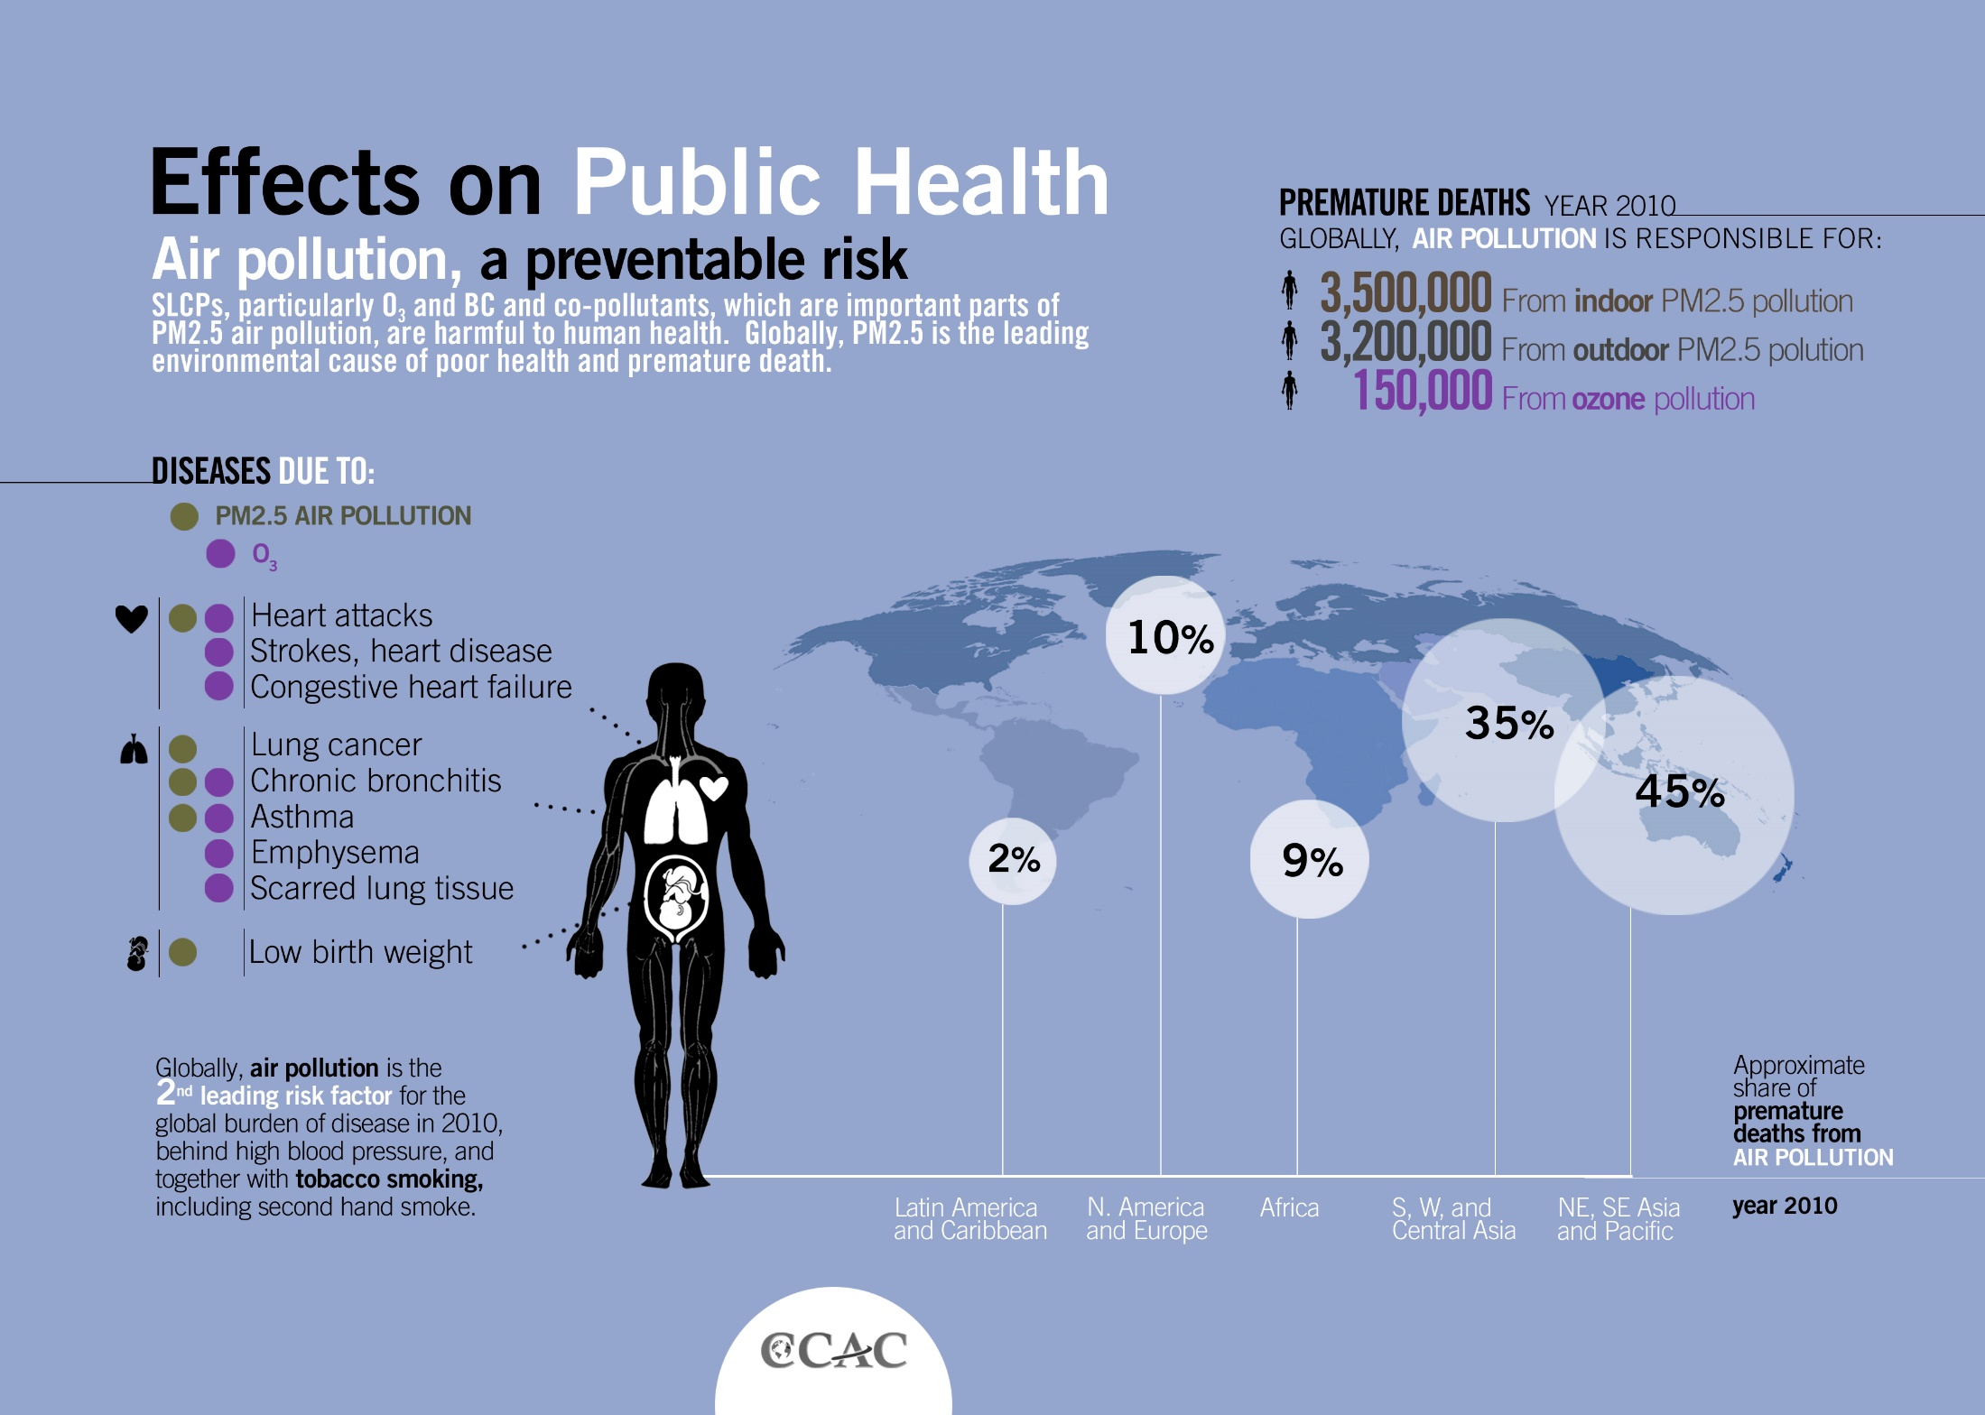

Slide 5
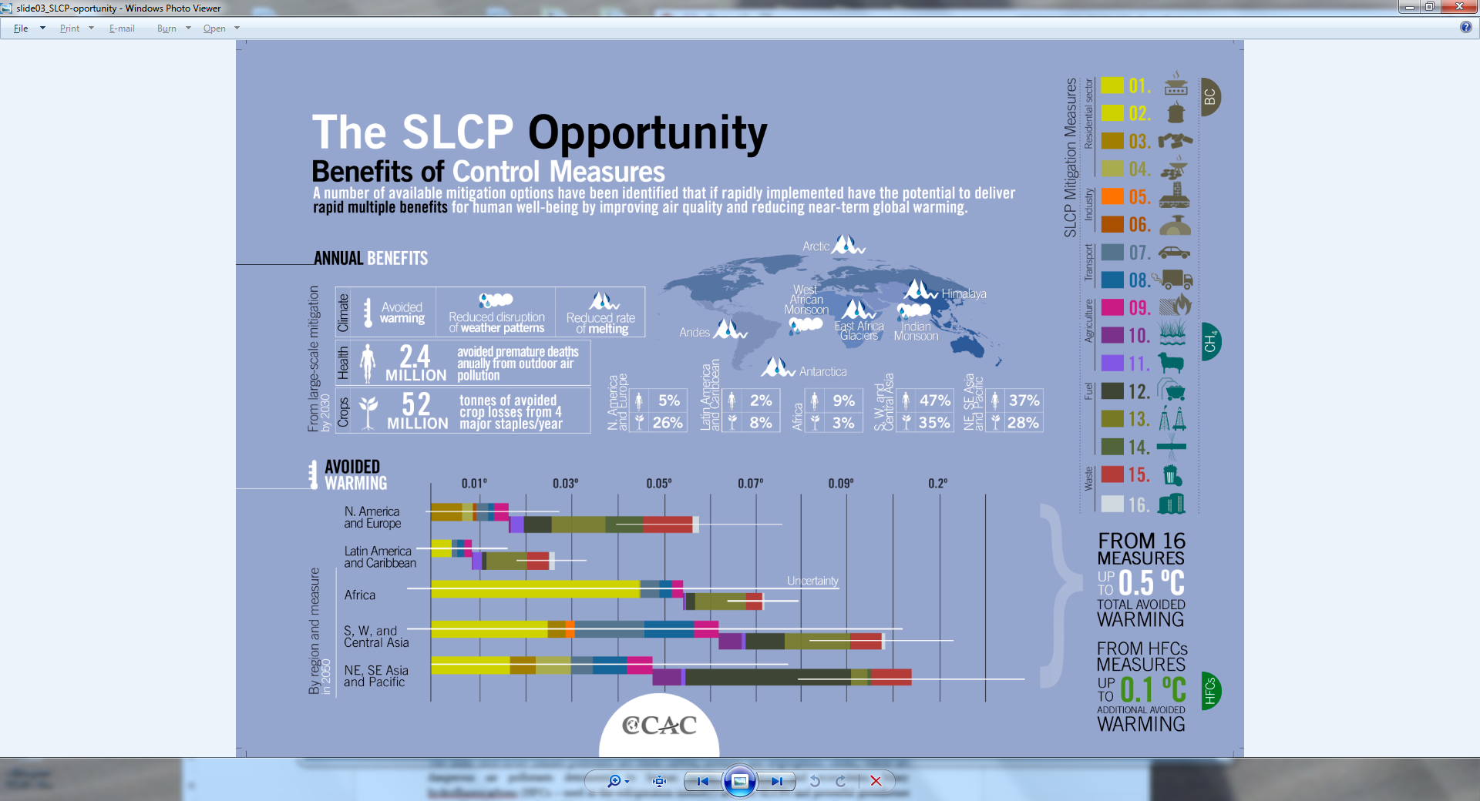
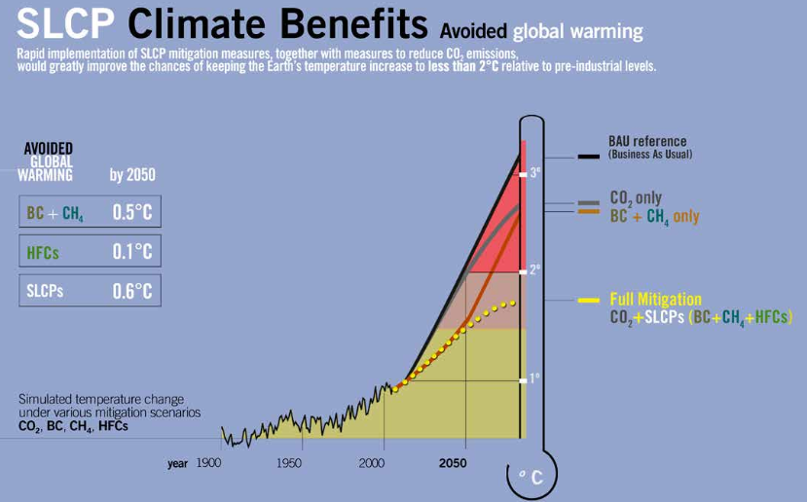
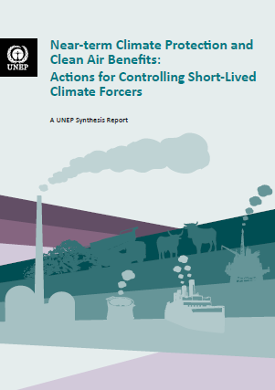
Notes:
Science underlying the action under the CCAC had produced compelling figures:
2.4 million avoided premature deaths from air pollution.
52 million tonnes of avoided crop losses from 4 major staples each year.
0.6 degree C avoided warming.
The graph shows that SLCP action and CO2 emission reductions need to go hand in hand; they have to be undertaken without any delay, and in a decisive manner. Only by action on both, SLCPs and CO2, will we stand a chance to stay within the 2 degree limit.

Slide 6
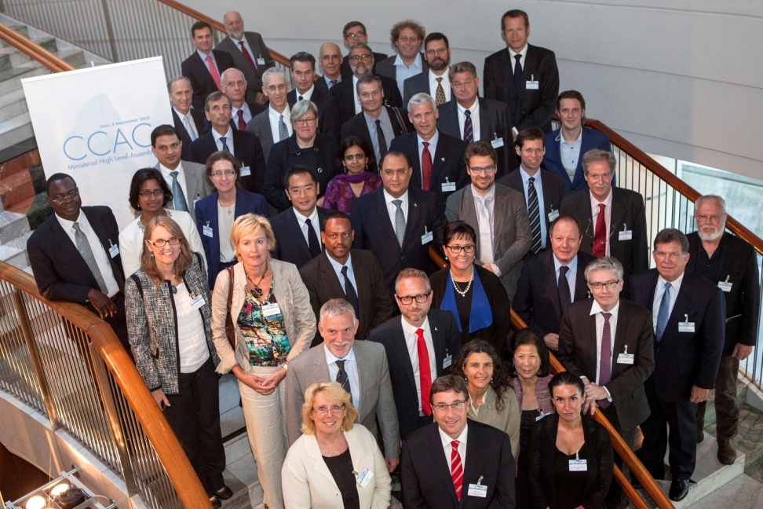
Climate & Clean Air Coalition
To Reduce Short-Lived Climate Pollutants
Voluntary, partner-led (total 100 now) “Coalition of the Working” – governments, IGOs, NGOs,private sector
First global effort to treat SLCPs as a collective challenge – based on science and initiatives – catalytic
11 transformative initiatives addressing measures to reduce Black Carbon, Methane and HFCs
Complementary to global efforts to reduce CO2 – and to improve air-quality, public health and crop yields
Political leadership
Action oriented
Raise awareness
Scale up good practice
Improve scientific understanding
Complementary
Notes:
[Introduce the CCAC]
Primary Strategy
Bring together many diverse, experienced, and influential players to leverage high-level engagement and political will across and beyond membership to catalyze concrete and substantial action to accelerate efforts to reduce SLCPs, with an initial focus on methane, black carbon, and many hydrofluorocarbons (HFCs), in ways that protect the environment and public health, promote food and energy security, and address near term climate change.
Coalition Objectives
The Coalition seeks to reduce SLCPs by: (1) raising awareness of SLCP impacts and mitigation strategies; (2) enhancing and developing new national and regional actions, including by identifying and overcoming barriers, enhancing capacity, and mobilizing support; (3) promoting best practices and showcasing successful efforts; and (4) improving scientific understanding of SLCP impacts and mitigation strategies.
Some key Aspects
Voluntary but all Partners have endorsed meaningful action to address SLCPs -> Coalition of the willing!
Light governance structure and can to tap into the institutional capacity of other entities, including its partners
Building on existing efforts. Not trying to reinvent the wheel, rather looking at what is there, what is missing and how such a Coalition with its specific assets, especially high level political leadership can help pull the trigger for scaling up and accelerating efforts and catalyze new action (e.g. in the area of Diesel, we are working with PCFV and a number of institutions, and looking at Heavy Duty Diesel Vehicles and engines which represent an important part of BC emissions from transport sector and where no specific programme existed.)
Science driven effort
Complementary to global efforts to reduce CO2, in particular under UNFCCC
Partner-led Coalition
All Partners have endorsed meaningful action to address SLCPs
All CCAC activities are developed and led by Partners
Success depends on each Partner engaging in the Coalition, but also playing their individual role played to reduce SLCPs beyond the direct action of CCAC and its initiatives. Work to capture this outside-the-CCAC efforts is underway.
Partner-led effort -> Coalition of the working, with efforts well underway
Meaning:
All activities are developed and led by Partners through a collaborative process;
Ultimate success depends directly on capacity dedicated by Partners to the Coalition (personnel, financial support and high-level political leadership)
and ability to generate and capture SLCP mitigation initiatives in developed and developing country Partners (not limited to activities funded by CCAC), and provision of support to such initiatives by non-state Partners, including private sector.
Stress that it is a collective effort and success depends on the engagement and central role played by each Partner

Slide 7
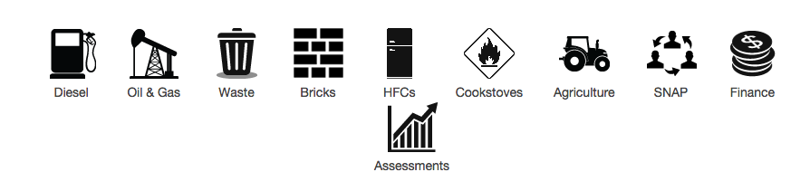
PROGRESSING
CCAC State Partners are increasing their actions to reduce SLCPs nationally
Awareness: SLCP action catalyzed in other fora
Fast action through 11 initiatives – from tools to capacity building to technology demonstration
Urban Health

Slide 8

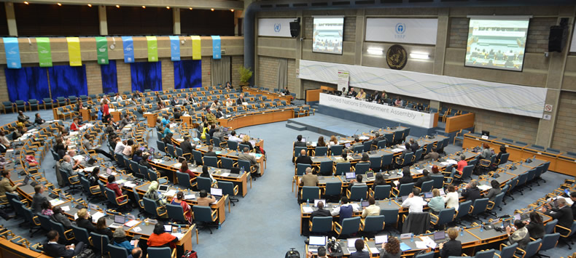




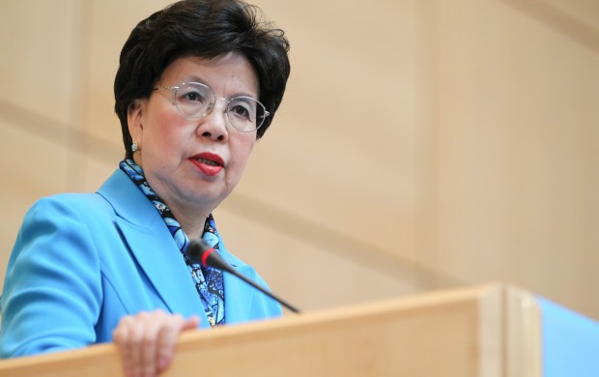

Progress in global policy & SLCPs
The first UN Environment Assembly approved a resolution on ‘Strengthening the role of UNEP in promoting air quality’.
now finances projects that address many SLCPs
Non-CO₂ gases at TEM under workstream 2, CCAC invited
October 2014 in Bonn
The Nordic Environment Finance Corporation helps financing Arctic Council Projects on pollution prevention & abatement.
The 66th World Health Assembly recognized the linkage between climate, air pollution and health.
SLCPs as a priority under the ‘Industry’ action area
$60 million funding pledged for methane reduction projects under the World Bank
Methane Pilot Auction Facility

Slide 9
Example: Chile is acting on CO₂ & SLCP – climate & airquality
Carbon Tax on transportation and energy sector.
Glacier protection law.
Ratification of 2009 Copenhagen commitment (20/20) in 2014. Looking for more ambition in Post 2030 scenario.
Montreal Protocol implementation makes HCFC control easier
Methane capture practices good for power generation, fuel for Santiago’s CNG taxi fleet.
Pollution attainment programs will integrate air quality and climate policy.

Slide 10
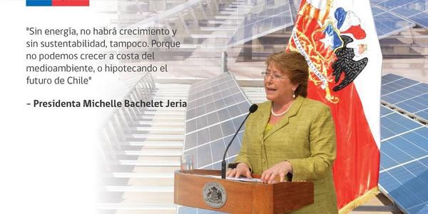
Clean Energy in Chile
Source: Ministry of Environment Chile

Slide 11

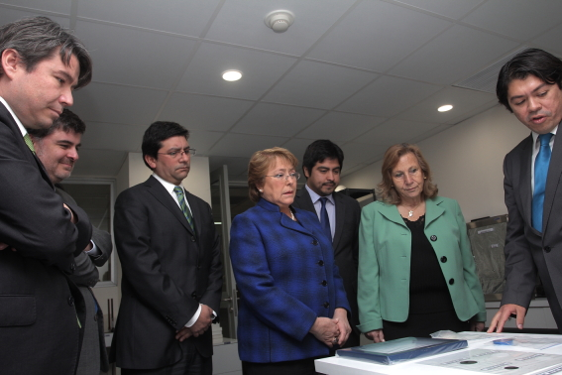
Chile: Presidential Measure 31.
Act on pollution
Source: Ministry of Environment Chile
14 pollution attainment programs in 4 year period.
Collaboration with Ministry of Health

Slide 12
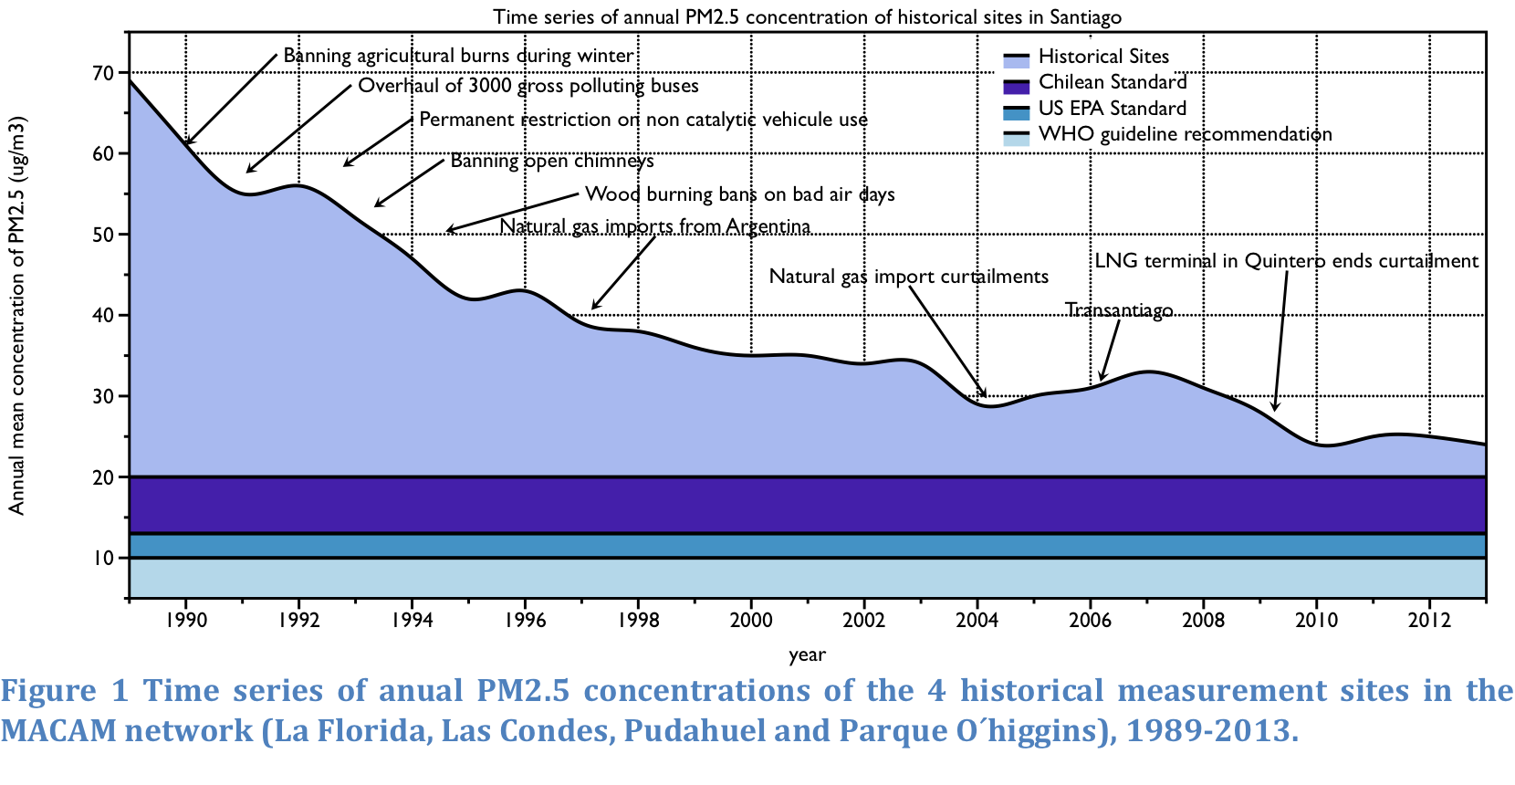
Santiago’s progress in air pollution
Source: Ministry of Environment Chile

Slide 13
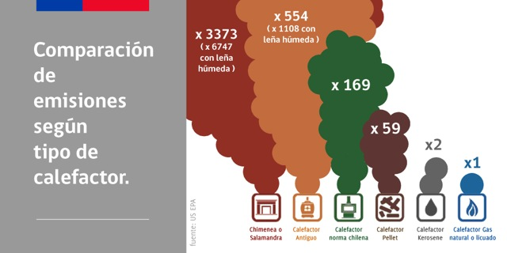
Heating a main problem - pollution
Source: Ministry of Environment Chile

Slide 14
Chile: Benefits of pollution attainment program
Effect | Type | Avoided cases /year
Premature mortality | Long term | 177
Hospital admissions | Asthma | 10
 | Cardiovascular | 70
 | Chronic respiratory disease | 12
 | Pneumonia | 30
Emergency room visits | Asthma | 6821
Lost work days | Complete loss | 43,107
 | Partial loss | 191.384
 | Minor restrictions | 370.030
Source: Ministry of Environment Chile

Slide 15
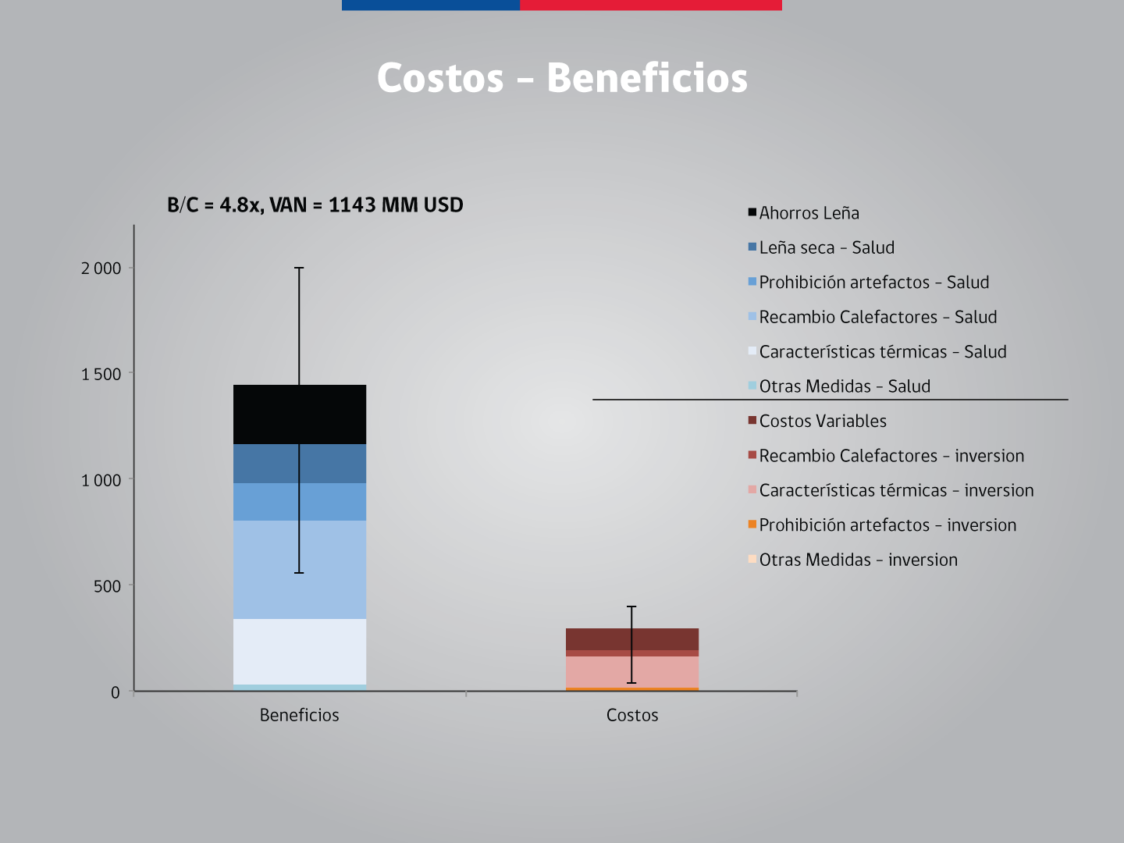
Source: Ministry of Environment Chile

Slide 16
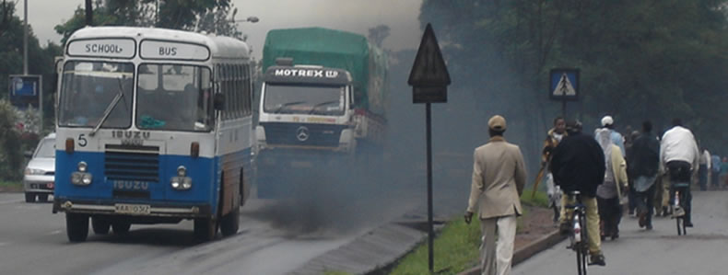
Heavy-Duty Diesel Vehicles & Engines
Long term goal: Virtually eliminate black carbon emissions from HDD vehicles
Regional and national regulatory processes to develop fuel quality and vehicle emission standards .
A White Paper on Best Practices in Reducing Emissions through Vehicle Replacement Programmes developed
PROGRESS HIGHLIGHTS
Notes:
An estimated 19 percent of global black carbon emissions come from the transportation sector. The Coalition Partners are working to virtually eliminate fine particles and black carbon emissions from new and existing heavy-duty diesel vehicles and engines by steadily reducing sulphur in diesel fuel, establishing more stringent vehicle emission standards with interested nations, cleaning up fleets and developing a global Green Freight initiative.
First results:
Activities in several countries in Asia and Latin America, and at regional level (including East Africa). Focus on advancing and implementing emissions regulations, exploring and identifying financial and policy mechanisms, and conducting outreach to key private-sector partners.
Chile: Conducted national black carbon inventory and created taskforce on heavy-duty diesel (HDD) vehicle standards. These paved the way to a national HDD road map and a black carbon reduction plan, which is now being developed
Peru: Established national task force and set target of 2016 for introduction of 50ppm sulphur diesel fuels
Asia: ASEAN Coalition for Cleaner Fuels and Vehicles created, with first meeting planned for November 2013
Bangladesh and Vietnam: Established national taskforces on HDD vehicles and are now working to further improve emission standards.
Next steps:
Scale up of the work in more countries and regions, including in port cities.
Promote cleaner fuels and vehicles through national standards and local policies in countries and regions, including China, Mexico, Indonesia, Latin America, East and West Africa.
Develop and launch global low sulphur diesel strategy.
Develop and launch Global Green Freight Action Plan over 2014 (to be discussed further at this meeting).

Slide 17
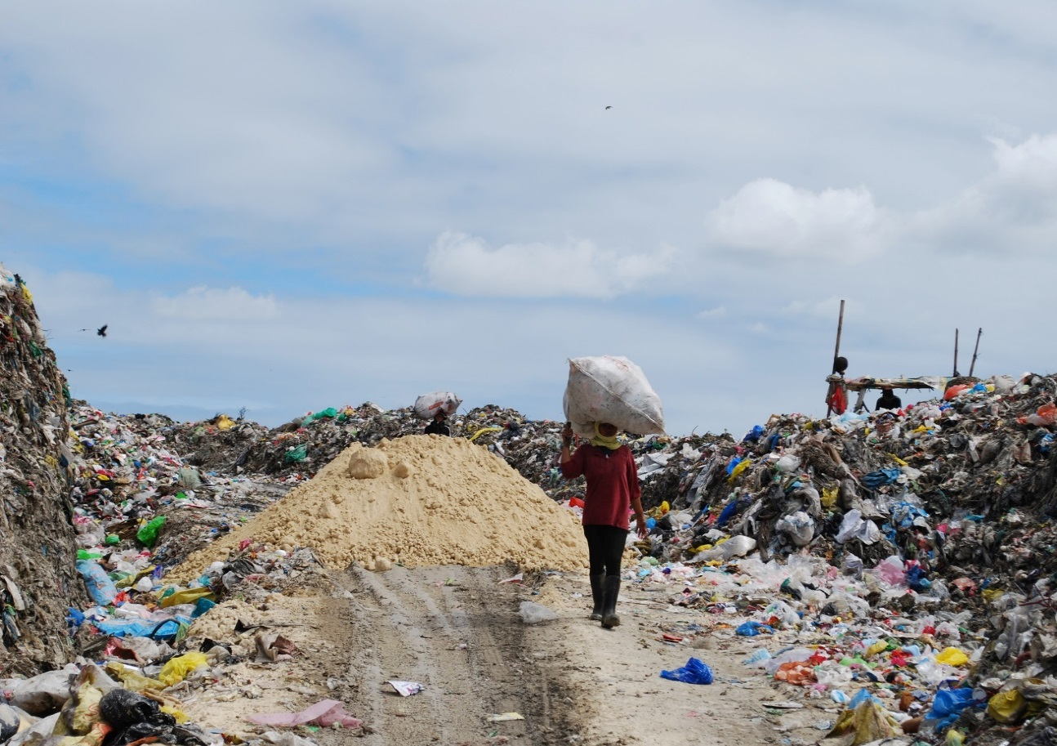
Municipal Solid Waste
Long-term goal: Reduce emissions in cities across the
solid waste sector; scale up through national policies
PROGRESS HIGLIGHTS
City baseline assessments of waste situation in 19 cities around the world
Pre-feasibility studies completed in 7 cities
city exchange programme to facilitate peer-to-peer learning up and running
Photo: Ylva Engqvist © CCAC
Notes:
Landfills are the third largest source of global anthropogenic methane emissions, and open garbage burning emits black carbon and other pollutants, including dioxin, a major health concern. The Coalition Partners are working directly with cities and national governments to reduce emissions of SLCPs across the municipal solid waste sector by providing a comprehensive collection of resources, including technical assistance, financial strategies, information exchange, networking, and training.
First results:
Work has started in cities that will implement new action on the ground, act as ambassadors in their countries and regions for showcasing best practices, and sharing lessons learned with other interested cities.
8 pilot cities have completed work plans with the initiative and are beginning to implement: (blue pins on map) Dhaka (Bangladesh); Rio de Janeiro (Brazil); Viña del Mar (Chile); Santiago de Cali (Colombia); Accra (Ghana); Penang (Malaysia); Ho Chi Minh City (Vietnam); Lagos (Nigeria); Three mentor cities : Stockholm (Sweden); San Francisco (US), San Diego (US).
9 more cities confirmed: (red pins) Concepción (Chile); Barranquilla (Colombia); Abidjan (Cote d’Ivoire); Addis Ababa (Ethiopia); Lima (Peru); Batambang (Cambodia), Phitsanulok (Thailand), Surabaya (Indonesia), Cebu ( Philippines).
Ongoing outreach to further cities including Chongqing (China); Pune (India); Jakarta (Indonesia); Sao Paolo (Brazil); Moscow (Russia); Amman (Jordan) as well as with CCAC partners.
Mentoring partnerships established, with initial relationships between San Diego and Cali, San Francisco and Concepción, and Stockholm and Viña del Mar.
Web-based knowledge platform launched for Initiative participants to interact with each other and access specific technical, capacity building, and awareness-raising services offered by the CCAC
International workshops held in Vancouver and Vienna (linked to the International Solid Waste Association Congress 2013) to bring cities together, hear experiences, and drive next steps for implementation.
Next steps:
Assist the pilot cities to take concrete action to reduce emissions by implementing their work plans, assist a further 10-15 cities to undertake city assessments, a broader number of cities to participate in regional training and benefit from the knowledge platform.
Launching an Asia Regional Component in Surabaya, Indonesia, (23-24 Feb 2014) with a workshop on city-to-city knowledge sharing and CCAC-led specific training to support city action.
An emissions quantification tool is being developed, which can be used by Initiative partners and participating cities to measure and monitor progress in reducing SLCPs through new projects. This tool will also enable the CCAC to track concrete progress.
Two cities will pilot a results-based/output-based funding mechanism – work on this has already started in pilot city Penang.
--> The Initiative will continue to work with individual cities in countries around the world to develop models of best practices for reducing SLCPs from waste. Participating cities are encouraged to become “centers of excellence” for their countries and mentor additional cities in their country and region to continue to promote such practices. The Initiative will also work with national governments to be able to put in place programs, policies and incentives that can help scale up action from individual cities to countrywide approaches.
[----MORE BACKGROUND INFO----]
Overall objective: The Initiative is fostering partnerships, political will, and technical capacity that directly support cities to take lasting action to significantly reduce short-lived climate pollutants from their waste streams.

Slide 18
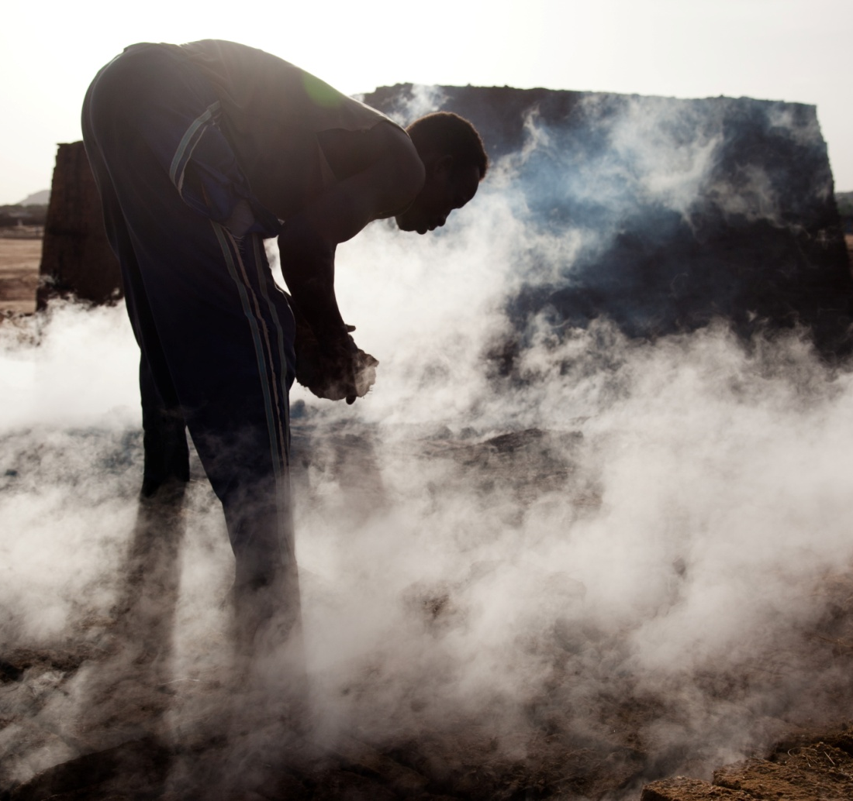
Brick Production
Long term goals: Increase political attention and build capacity to mitigate the emissions impact of this sector.
PROGRESS HIGHLIGHTS
Policy and Advocacy Networks for South Asia and LAC
Assessment Reports on brick production in Brazil, Chile, Colombia, Mexico, and Nigeria
Work in progress: emission tool
Notes:
Brick production is an important source of black carbon and other pollutants. Cleaner brick production alternatives exist, including mechanized and high-energy-efficient technologies. The Coalition Partners aim to increase political attention and build capacity to mitigate the emissions impact of this sector.
First results:
This initiative has evolved into the ONLY global platform focusing on the brick production sector, addressing economic, social, environment and health issues, and has built a first set of region specific awareness raising material.
Colombia and Mexico: Drafted national strategies to address brick production emissions
Brazil and Nigeria: Preparing reports on existing policies and production
Mexico and Nepal: Held regional/global workshops on technology, capacity building and public policy.
Global task force established to guide the initiative’s work
Tools created to raise awareness among policymakers, kiln owners, media, the finance sector and potential donors
Web-based knowledge platform developed.
Next steps:
Expand the networks on policy and technology
Build localized training nodes to promote already proven technologies and practices in Asia and Latin America
Prepare and present the business case for modernization of the brick sector to the financial sector
Explore a market-based pilot project on “green bricks” in Latin America.
[----MORE BACKGROUND INFO----]
Brick kiln production is responsible for substantial air pollution in many cities of the world.
Overall objective of the initiative: The overall objective of the CCAC brick kiln initiative is to achieve substantial reductions of black carbon and other emissions from brick kilns. Employing a range of technology and policy approaches, the initiative will work both with governments and brick kilns owners to promote emissions abatement and to prevent new emissions. In doing so, climate impacts will be reduced, local air quality will be improved, and other health, social, and environmental co-benefits will be achieved.

Slide 19
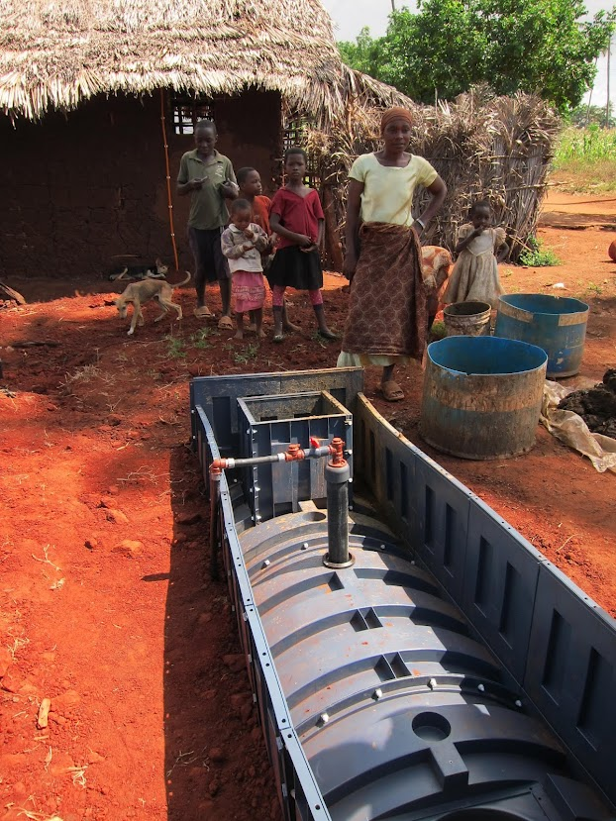
Household cooking & domestic heating
Long term goals: Reduce black carbon from traditional cookstoves, heatstoves, and open fires through market-based programs
PROGRESS HIGHLIGHTS
Global Alliance Spark Fund financing innovative projects reducing black carbon in Tanzania and Nigeria
Adding black carbon to emerging stove emissions standards
Notes:
Household cooking and heating are a major source of harmful black carbon emissions. The Coalition Partners aim to speed up reductions in SLCP emissions through high-level advocacy, support for new finance mechanisms, new research, and development of standards and testing protocols to provide clear criteria for evaluating emissions reductions for improved cookstoves, heatstoves and fuels.
First results:
The first phase funding has just been approved, and workplan developed.
Next steps:
Upcoming activities will focus on:
A high-level advocacy and global education campaign to raise awareness among thought- leaders and policy-makers regarding the contribution to climate change from the use of solid fuels in traditional cookstoves and open fires
Expansion of the Spark Fund to include a special tranche of pre-investment grant support for projects that reduce emissions of SLCPs
Development of standards and testing protocols to provide clear criteria for evaluating emission reductions of black carbon, PM and other SLCPs, and other co-benefits, from the wide-spread adoption of clean cookstoves, heatstoves, and fuels.
[----MORE BACKGROUND INFO----]
Recent study estimates that residential cooking and heating with sold fuels accounts for 20 % of the global BC emissions
1) Overall Objective: Reduce emissions of black carbon and SLCPs from the use of traditional cookstoves, heatstoves, and open fires through market-based programs that promote the adoption of clean cookstoves, heatstoves, and fuels, and leverage associated benefits to health, air quality, gender, and livelihoods

Slide 20
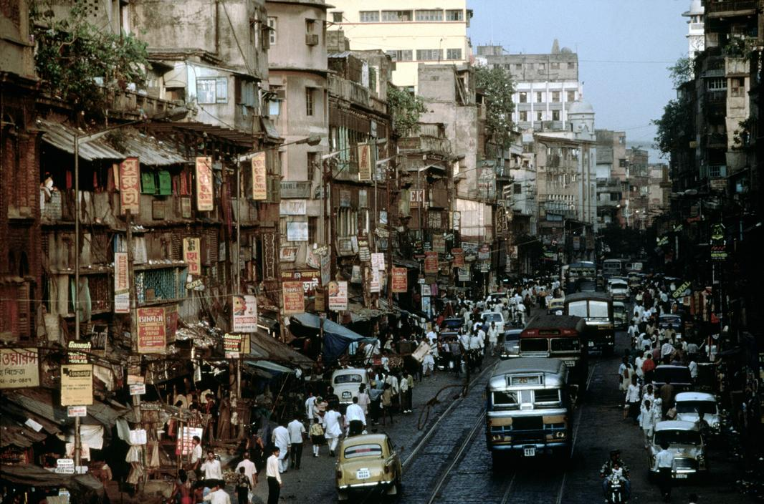
Urban Health Initiative
Long term goals: Realize SLCP reductions in cities by reinforcing the
linkage between SLCP and air pollution mitigation and health benefits
PROGRESS HIGHLIGHTS
Launched a preliminary assessment to equip health and development sectors and city officials with information and tools for assessments of air pollution and SLCP impact on health
Interested cities and health care organizations should contact CCAC Secretariat to participate
Notes:
The Urban Health Initiative is initially focusing on listening, learning, information-gathering and awareness-raising about air quality and climate issues through participation in high-level conferences in those regions most affected by air pollution.
Following the scoping phase, pilot cities will be selected for further in-depth work, building on synergies with other CCAC initiatives and complementing other national and international initiatives to reduce urban air pollution.
At the World Health Assembly in May 2015, the conclusions from these discussions will be shared with Health Ministers to bolster a worldwide effort to improve air quality and slow down the rate of global warming.
Local government officials, city planners and organizations working in cities to promote air quality and improve public health are urged to contact the CCAC Secretariat to participate – to help shape the initiative.

Slide 21
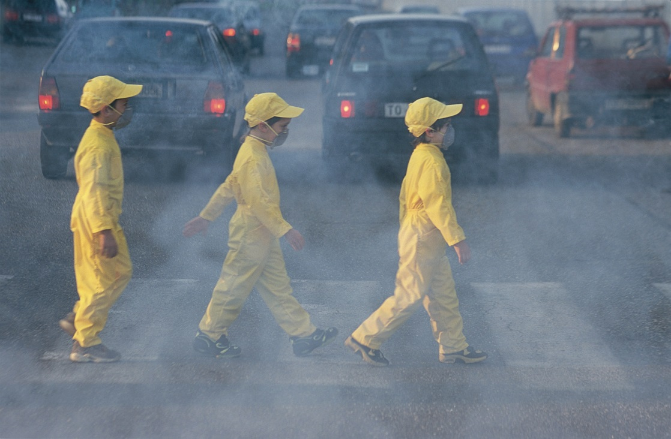
“Clean Air in Every Breath” Global Campaign
Long term goals: Raise global awareness about health and climate benefits from reducing SLCPs in sectors, cities and rural areas to reduce indoor and outdoor air pollution
PROGRESS HIGHLIGHTS
Global Awareness Campaign underway; events and opportunities by sector and leading up to World Health Assembly, May 2015
© Still Pictures
Notes:
Highlight:
Synthesis report on SLCPs and health to be released in early 2015
Sharing key messages at events:
World Congress on Public Health (Calcutta, February 2015),
ICLEI - Resilient Cities Asia (Bangkok, February 2015)
Planning underway for large-scale global events

Slide 22
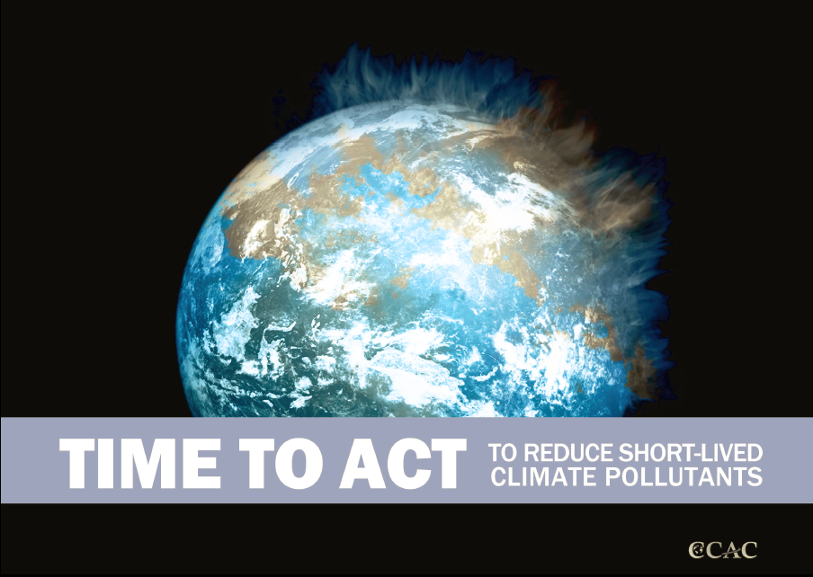
For more information:
CCAC Secretariat
Email: ccac_secretariat@unep.org
www.ccacoalition.org
Twitter: @ccacoalition
#SLCPs #TimeToAct

